Slide 1

RDM @ Edinburgh
Stuart Macdonald
Associate Data Librarian
EDINA & Data Library
stuart.macdonald@ed.ac.uk
RDM & ELN Information Sharing Workshop for HE,
Scottish Universities Insight Institute
University of Strathclyde
17 Nov. 2015

Slide 2
Background
EDINA and Data Library (EDL) are a division within Information Services (IS) of the University of Edinburgh.
EDINA is a Jisc centre for digital expertise providing national online resources for education and research.
Data Library & Consultancy assists Edinburgh University users in the discovery, access, use and management of research datasets. The Data Library is part of the new Research Data Service.
Data Library Services: http://www.ed.ac.uk/is/data-library
EDINA: http://edina.ac.uk/
Notes:
25 years ago
disk storage - expensive
researchers interested in working with data came together to petition the PLU and the University’s Library – wanting a university-wide provision for files that were too large to be stored on individual computing accounts
Early holdings were research data from universities of edinburgh, glasgow, and strathclyde

Slide 3
Outline
Defining research data
Research Data Management (RDM)
RDM benefits & drivers
Funder requirements & University expectations
RDM data services
RDM support

Slide 4

Defining research data
Research data are collected, observed or created, for the purposes of analysis to produce and validate original research results.
Data can also be created by researchers for one purpose and used by another set of researchers at a later date for a completely different research agenda.
Digital data can be:
  created in a digital form ('born digital')
  converted to a digital form (digitised)

Slide 5
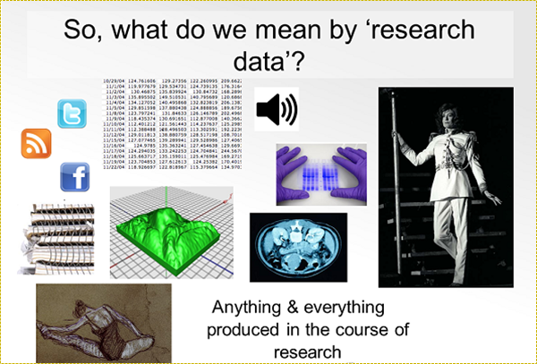
Notes:
Instrument measurements, Experimental observations, Still images, video and audio, Text documents, spreadsheets, databases
Quantitative data (e.g. household survey data), Survey results & interview transcripts’, Simulation data, models & software, Slides, artefacts, specimens, samples, Sketches, diaries, lab notebooks,

Slide 6
Research Data Management (RDM)
Data management is a general term covering how to organise, structure, store, and care for the data used or generated during the lifetime of a research project.
It includes:
  How you deal with data on a day-to-day basis over the lifetime of a project,
  What happens to data after the project concludes.
RDM is considered an essential part of good research practice.

Slide 7
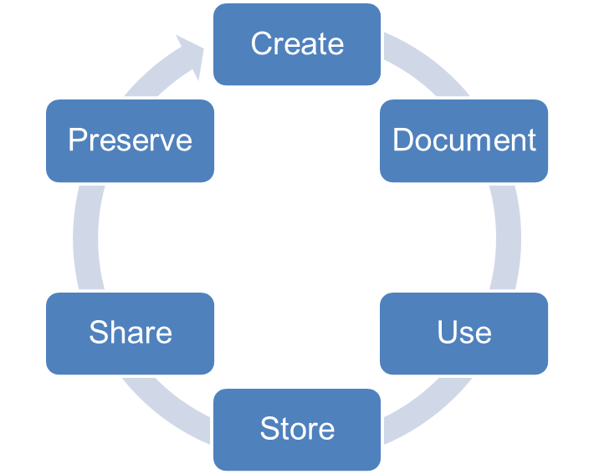
Activities involved in RDM
Type, format volume of data, chosen software for long-term access, secondary data, file naming, structure, versioning, quality assurance processes.
Select retention period, repository choice, costs involved in long-term storage?
Information needed for the data to be understood in future, metadata standards, methodology, definition of variables, format & file type of data.
Data Management Planning
Day-to-day management of data
Long-term management of data
Make data publicly available (where possible) at the end of a project, license data, any restrictions on sharing, access controls?
Access restrictions, risks to data security, appropriate methods to transfer / share data, encryption, legal, ethical issues.
Secure & sufficient storage for active data, regular backups, disaster recovery

Slide 8
Why manage your data?
To meet funder / university / industry requirements.
So you can find and understand it when needed.
To avoid unnecessary duplication & increase efficiency.
To validate results if required.
So your research is visible and has impact.
To get credit when others cite your work.
To avoid data loss

Slide 9

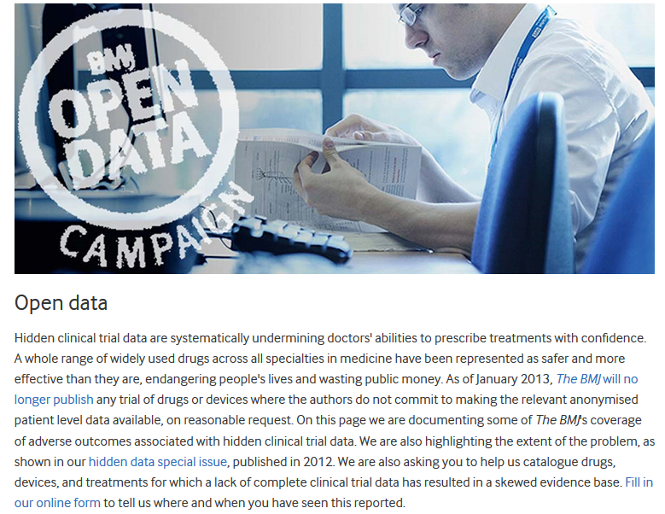
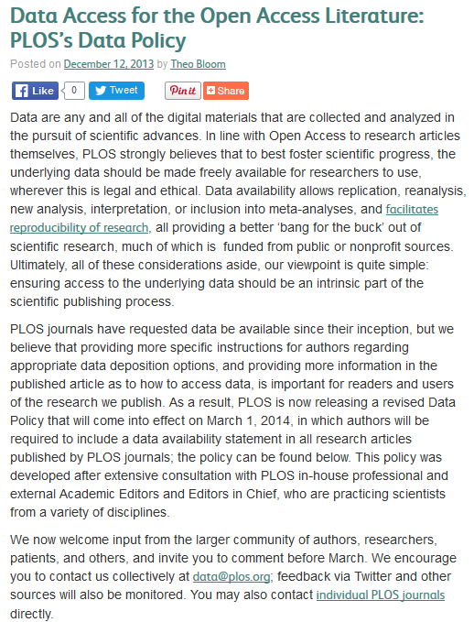

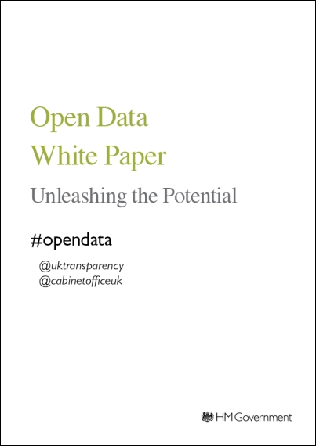

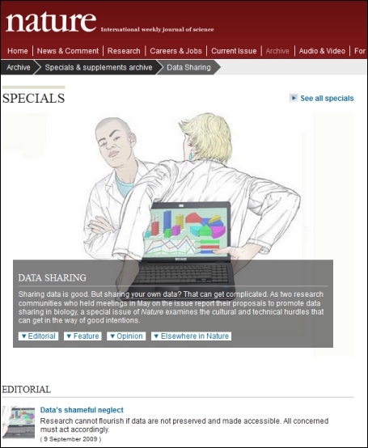
Drivers of RDM
“Publicly funded research data are a public good, produced in the public interest, which should be made openly available with as few restrictions as possible in a timely and responsible manner that does not harm intellectual property.”
RCUK Common Principles on Data Policy
http://www.rcuk.ac.uk/research/datapolicy/
Image by Gareth Knight, London School of Hygiene & Tropical Medicine

Slide 10
Funder requirements
Funders are increasingly requiring researchers to meet certain data management criteria.
When applying for funding, you need to submit a technical or data management plan.
You are expected to make your data publicly available (where appropriate) at the end of your project.

Slide 11
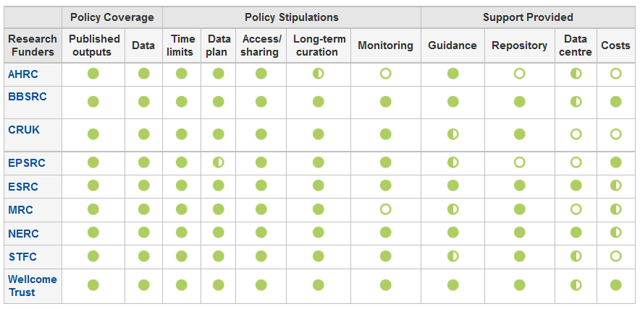
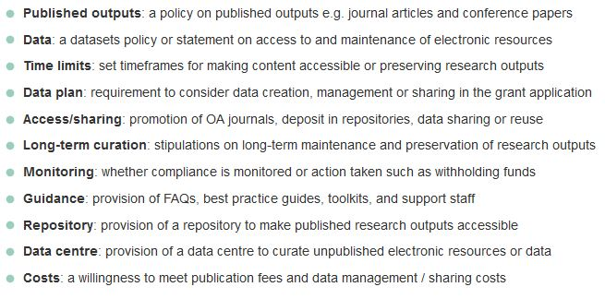
What do Funders want?
http://www.dcc.ac.uk/resources/policy-and-legal/overview-funders-data-policies

Slide 12
EPSRC
Expects that:
published research papers should include a short statement, describing how and on what terms any supporting research data may be accessed,
metadata on the research data they hold will be published by institutions within 12 months of data generation,
data will be securely preserved for a minimum of 10 years from the date of last 3rd party access.
https://www.epsrc.ac.uk/about/standards/researchdata/expectations/
https://www.epsrc.ac.uk/files/aboutus/standards/clarificationsofexpectationsresearchdatamanagement/

Slide 13
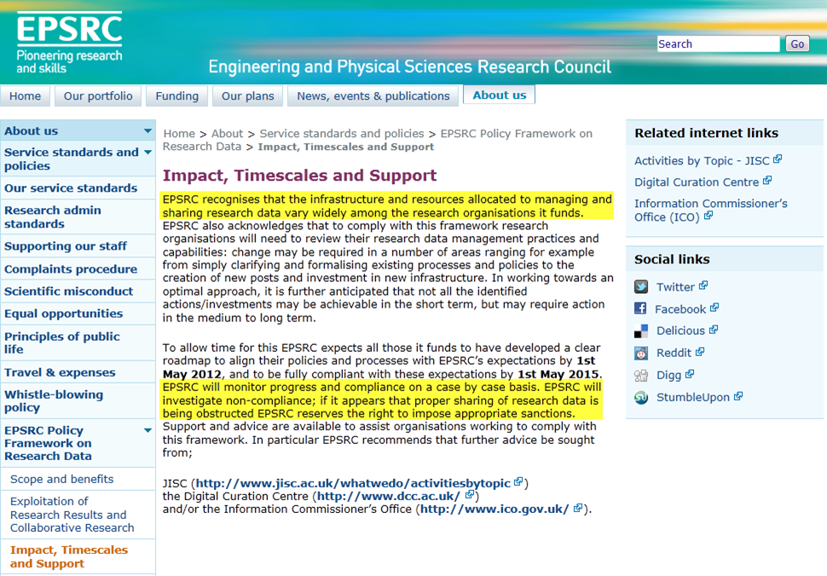
EPSRC Policy Framework on Research Data
http://www.epsrc.ac.uk/about/standards/researchdata/impact/

Slide 14
RCUK Concordat
Research Councils UK (RCUK) published a draft Concordat on Open Research Data (August 2015):
Sets out expectations of good practice in publishing research data openly
Lists 10 principles on working with research data.
Applies to all fields of research.
Emphasises stakeholder responsibility and accountability (institution, researcher, funder)
Recognises the autonomy of researchers.
Complements existing frameworks.
http://www.rcuk.ac.uk/RCUK-prod/assets/documents/documents/ConcordatOpenResearchData.pdf
Notes:
Follows on from the RCUK Common Principles on Data Policy (2011 – revised Apr. 2015) – publicly-funded research data are a public good, produced in the public interest, should be made openly available with as few restrictions as possible, data should be discoverable for re-use with sufficient metadata and documentation, all users of research data should acknowledge or cite sources, Data with acknowledged long terms value should be preserved and remain accessible for future research

Slide 15
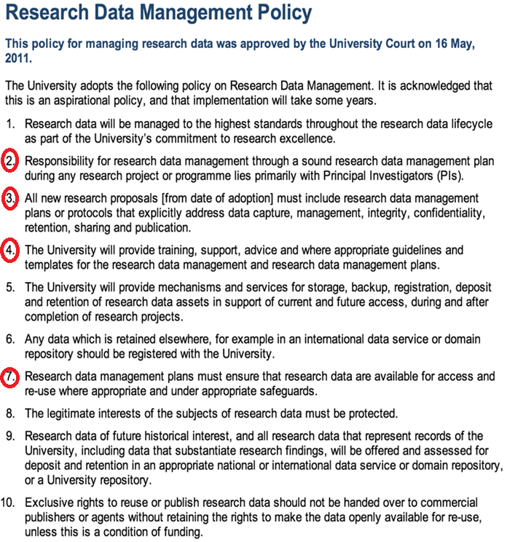
University of Edinburgh’s RDM Policy requirements
Research data will be managed to the
highest standards throughout the
research data lifecycle as part of the
University’s commitment to research
excellence.
All new research proposals must
include research data management
plans…
Research data management plans must
ensure that research data are available
for access and re-use where appropriate…
http://www.ed.ac.uk/schools-departments/information-services/about/policies-and-regulations/research-data-policy

Slide 16
Research Data Service at the University of Edinburgh

Slide 17
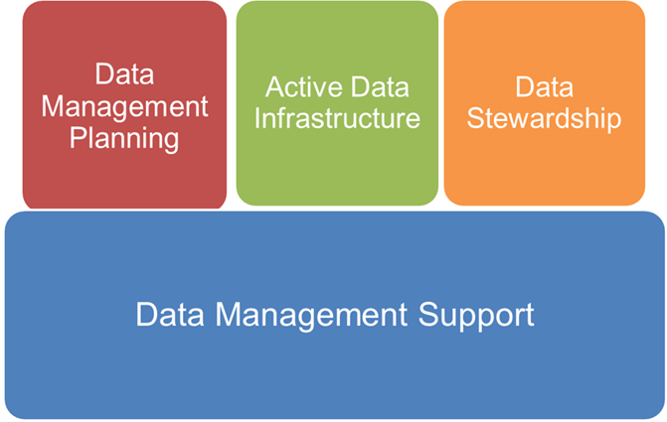
Implementation: RDM Roadmap
Research Data Management Roadmap to implement the policy (v.2)
http://www.ed.ac.uk/information-services/about/strategy-planning/rdm-roadmap

Slide 18
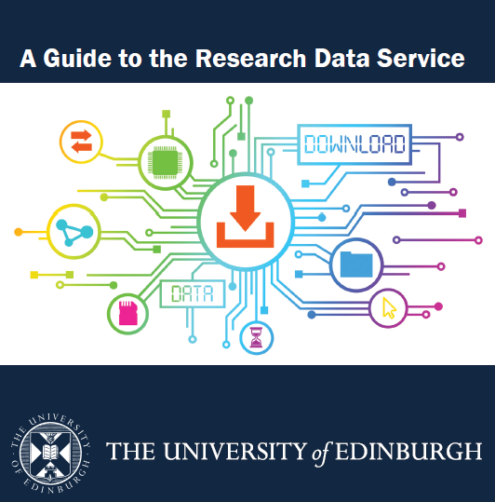
Research data services
DMPonline
DataShare
DataStore
DataVault
DataSync
PURE
http://www.ed.ac.uk/files/atoms/files/rdm_service_a5_booklet_0.pdf

Slide 19
What is a Data Management Plan?
DMPs are written at the start of a project to define:
What data will be collected or created?
How data will be documented and described?
Where data will be stored?
Who will be responsible for data security and backup?
Which data will be shared and/or preserved?
How data will be shared and with whom?
  DMPs are often submitted as part of grant applications, but are useful in their own right whenever you are creating data.

Slide 20
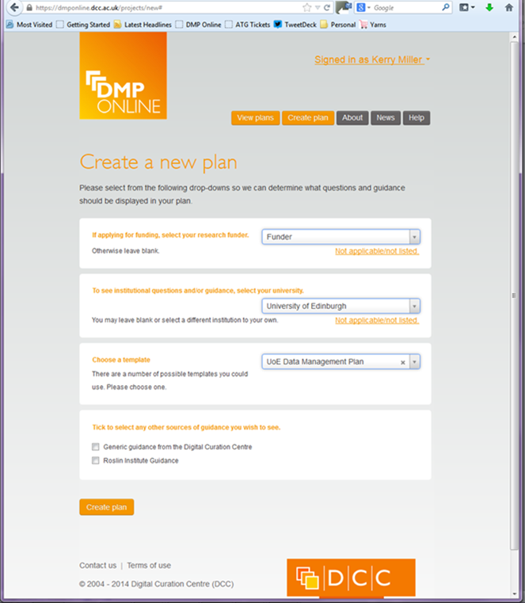
DMPonline
Free and open web-based tool to help
researchers write plans:
https://dmponline.dcc.ac.uk/
  Funder templates
  Tailored guidance (disciplinary,
  funder etc.)
  Customised exports to a variety
  of formats
  Ability to share DMPs with others
Edinburgh has started the process of
customising DMPonline for its
researchers.
DMPonline screencast:
http://www.screenr.com/PJHN

Slide 21
Supporting researchers with DMPs
Various types of support we will provide:
Guidelines and templates on what to include in plans.
Example answers, guidance and links to local support
A library of successful DMPs to reuse.
Training courses and guidance websites.
Tailored consultancy services.
Online tools (e.g. customised DMPonline).

Slide 22
DataStore
The facility to store data that are actively used in current research activities.
0.5 TB (500GB) per researcher, PGR upwards
Up to 0.25TB of each allocation can be used to create “shared” group storage.
Cost of extra storage: £200 per TB per year= 1TB primary storage, 10 days online file history, 60 days backup, DR copy.
Integration with ECDF (‘Eddie’) high performance computing cluster & RSpace ELNs

Slide 23
Accessing DataStore
Allocation will be provided as a mapped drive (M: U: etc.) on staff desktops
Connect via “Run” or “Explorer” on Windows, or
      “connect to server” on Mac/Linux*
Off-site access – VPN first, or use “SFTP”
NFS available for fixed-location Linux desktops
Documentation links:
http://www.ed.ac.uk/schools-departments/information-services/computing/desktop-personal/network-shares/accessing-datastore-net-shares-win
http://www.ed.ac.uk/schools-departments/information-services/computing/desktop-personal/network-shares/accessing-datastore-net-shares-mac

Slide 24
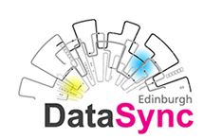
'Dropbox-like’ file-hosting service for non-sensitive data: ww.ed.ac.uk/is/datasync
Allows sharing and synchronisation of data.
Share using local clients or web URL with colleagues anywhere.
20GB free storage or map to personal / group data on DataStore as required.
Using the ownCloud open source application.

Slide 25

Data Vault
Safe, private, store of data that is only accessible by the data creator or their representative.
Secure storage:
File security
Storage security
Additional security
Encryption
Being developed as a community deliverable as part of a joint project with the Univ. of Manchester and partly funded by JISC.
Full version will be in place in mid-2016.
DataVault demo: http://demo.datavaultplatform.org/

Slide 26
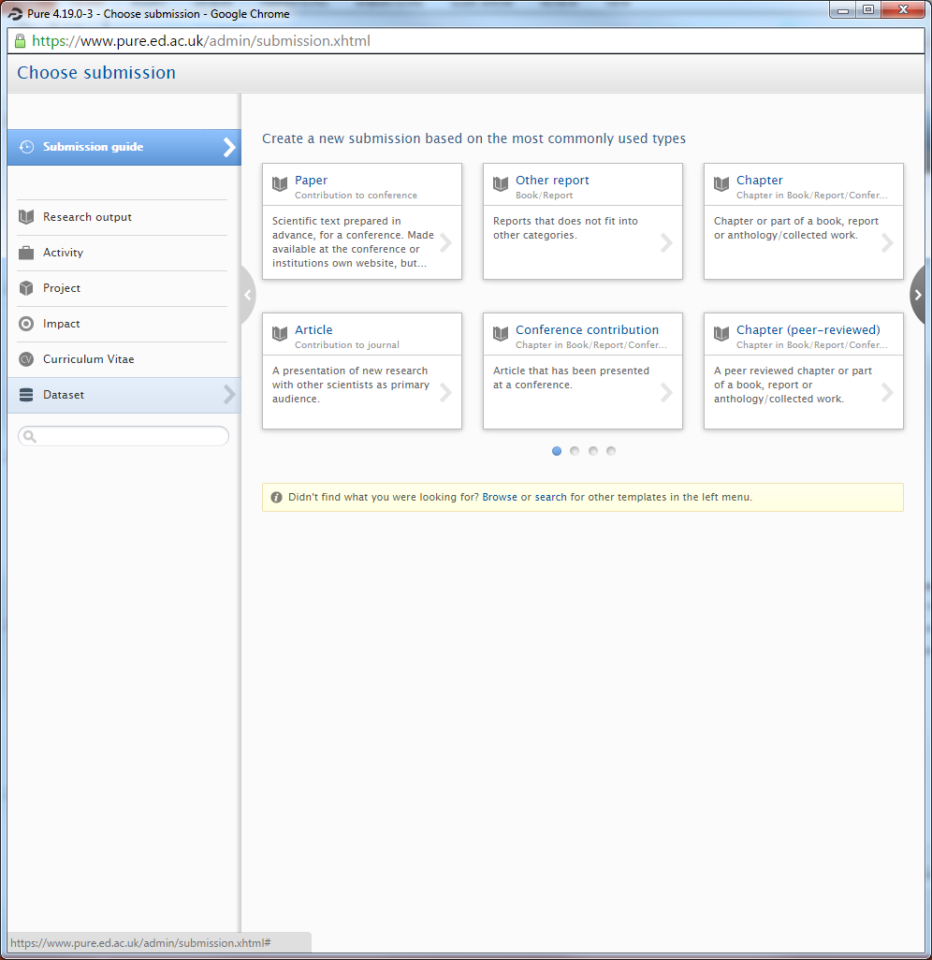
PURE: Describing your data
You can describe your datasets (creating metadata) in PURE (datasets field): http://edin.ac/1OF8Auq
Doing this will help your datasets to be discovered, accessed, and reused as appropriate.
Metadata records (along with those from DataShare) to be harvested by a national research data discovery service (UKRDDS)
Ready to use.

Slide 27
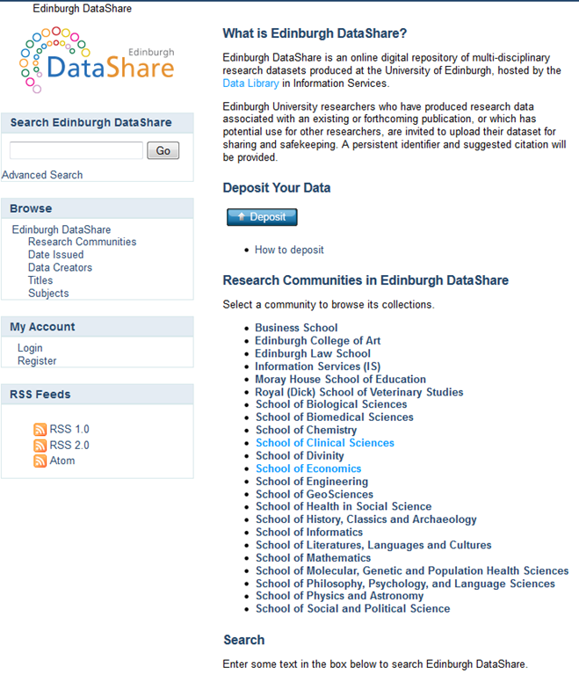
Edinburgh DataShare
Edinburgh DataShare is the University’s OA multi-disciplinary data repository hosted by the Data Library : http://datashare.is.ed.ac.uk
Assists researchers who want to:
  share their data,
  get credit for data publication
  preserve their data for the long-term (DOI, licence, citation)
It can help researchers comply with funder requirements to preserve and share their data and complies with Edinburgh’s RDM Policy
http://datashare.is.ed.ac.uk

Slide 28

Data preservation …
… requires a trusted repository.
Research-funders
    ESRC data store: http://store.data-archive.ac.uk/store/
    Zenodo (EU): https://zenodo.org/
Institutional (UoE)
    Edinburgh DataShare: http://datashare.is.ed.ac.uk/
Discipline-specific
  Archaeology Data Service: http://archaeologydataservice.ac.uk/
Discipline-agnostic
    Figshare: http://figshare.com/
Notes:
Horizon 20-20 Open Data Pilot

Slide 29
External repositories
When choosing an external repository or archive researchers should consider:
Does their funder require data to be offered to a domain repository?
Is the repository sustainable? What will be done with their data if the repository closes down?
How much will it cost? Are costs upfront or annual?
How does the repository promote discoverablity?
Does the repository record when data is accessed, downloaded, or cited for purposes of recognition and academic reward?

Slide 30
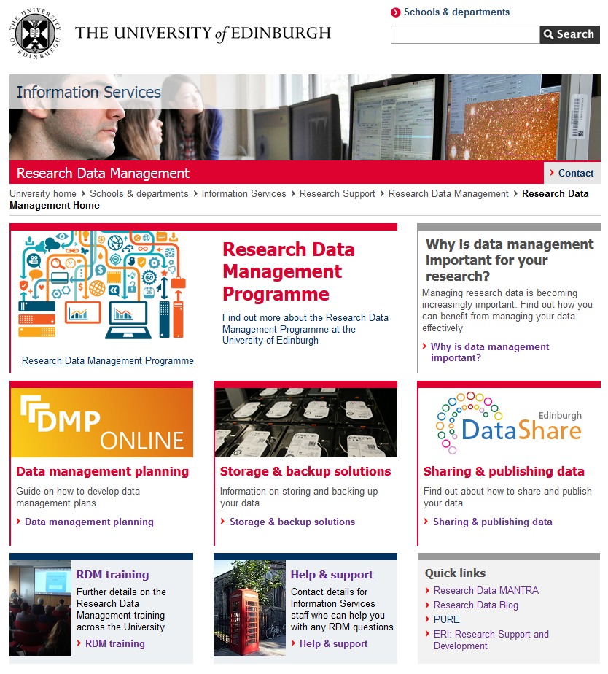
RDM Support
http://www.ed.ac.uk/is/data-management
Introductory sessions on RDM: contact
IS.Helpline@ed.ac.uk for a session for your School or subject group.
RDM website: http://www.ed.ac.uk/is/data-management
RDM blog: http://datablog.is.ed.ac.uk
RDM wiki:
https://www.wiki.ed.ac.uk/display/RDM/Research+Data+Management+Wiki

Slide 31
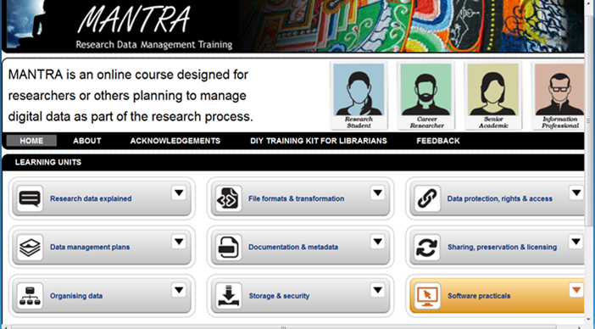
MANTRA
MANTRA is an internationally recognized self-paced online training course developed by the Data Library Team for PGR’s and early career researchers in data management issues.
Anyone doing a research project will benefit from at least some part of the training (and you can pick and choose).
Data handling exercises with open datasets in 4 analytical packages: R, SPSS, NVivo, ArcGIS.
http://datalib.edina.ac.uk/mantra
New – Research Data Management and Sharing MOOC (in conjunction with UNC-Chapel Hill) - https://www.coursera.org/learn/data-management

Slide 32
Training: Tailored courses
Creating a data management plan for your grant application
Working with personal and sensitive data
Good practice in Research Data Management
Handling data using SPSS
Visualising data using ArcGIS / QGIS
Registration via MyED:
  http://edin.ac/1kRMPv3
A range of training programmes on RDM in the form of workshops, seminars and drop in sessions to help researchers with research data management issues
http://www.ed.ac.uk/schools-departments/information-services/research-support/data-management/rdm-training

Slide 33
Resourcing & staffing
RDM Programme:
2012 – 2015 funded internally (c. £1.2 Million)
75% - infrastructure / storage
25% - staffing (recurrent for 3 years)
MANTRA and DataShare – originally Jisc project funding
From RDM Programme (fixed term):
Data Library: 2.5 FTE equivalent
( + 2.5 FTE equivalent core funding)
IT Infrastructure: 2 FTE equivalent
Research & Library Services: 2 FTE equivalent
Following RDM training the job description of all Academic Support Librarians have been restructured to incorporate DMP Support.

Slide 34

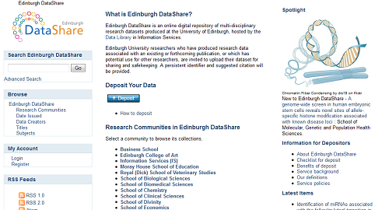



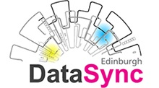
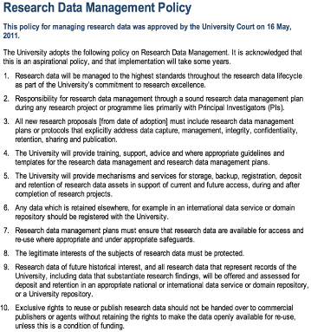
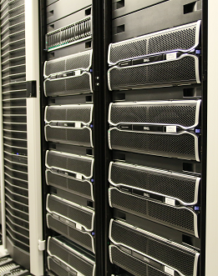

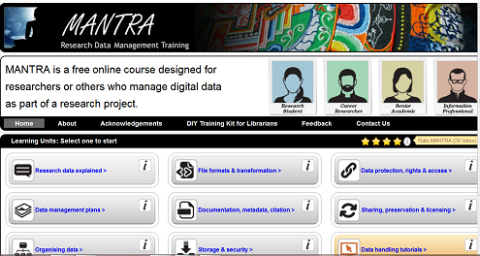
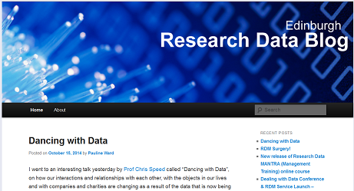
Data catalogue in PURE
Ready by mid-2016
http://edin.ac/1OF8Auq
http://datashare.is.ed.ac.uk/
https://dmponline.dcc.ac.uk/
http://www.ed.ac.uk/is/datasync
http://www.ed.ac.uk/files/atoms/files/rdm_service_a5_booklet_0.pdf
RDM at the University of Edinburgh
http://www.ed.ac.uk/is/research-data-policy
DataStore
http://datalib.edina.ac.uk/mantra/
http://datablog.is.ed.ac.uk/
www.ed.ac.uk/is/data-management

Slide 35
Questions?

Slide 36
Electronic Laboratory Notebooks (ELNs) @ Edinburgh

Slide 37
Outline
RSpace
Development and integration with University of Edinburgh RDM services
Observations on current use of ELNs
(gathered from informal emails and conversations with School computing officers and IT Consultants)

Slide 38

RSpace ELN (a Lab-Ally product) is a secure enterprise grade Electronic Lab Notebook (ELN) - http://lab-ally.com/products/rspace-eln/
Late 2013: Discussions began to integrate RSpace into University of Edinburgh RDM Services.
Early–mid 2014: Work started to:
Develop RSpace back-end to integrate with three University of Edinburgh RDM Services: DataStore, DataShare, (and Data Vault)
Scalable for similar integrations at other large research institutions

Slide 39
To provide the platform for integration with DataShare (and planned integration with Data Vault):
A configurable export-to-XML capability was developed in RSpace to enable exportation of digital objects at both lab level and the individual researcher.
Preparatory work was carried out to integrate RSpace with UoE authentication and authorisation service EASE
RSpace developers worked with DataShare to develop DataShare’s SWORD API to allow Edinburgh RSpace users to deposit data (XML zip files ) directly into DataShare via an easy-to-use wizard.
A similar integration is anticipated between RSpace and Data Vault.

Slide 40
After DataShare integration was complete, RSpace worked with UoE IT Infrastructure to integrate RSpace and DataStore, the active data infrastructure
This enables researchers to access files in DataStore by designating folders they have access to within the RSpace environment to facilitate sharing
An initial trial of RSpace was rolled out to ten labs in November 2014 with two labs in Schools of Biological Sciences (Prof. Judi Allen) & School of Biomedical Sciences (Prof. Mike Shipston) actively using RSpace.

Slide 41

RSpace and Edinburgh RDM
DataStore
DataShare
RSpace
server
User / Browser
DataVault
Slide courtesy of Rory Macneill (CEO RSpace)

Slide 42
Observations from School Computing Officers and IS IT Consultants on current use of ELNs
College of Medicine and Veterinary Medicine (CMVM):
Roslin Institute: “At Easter Bush we don't have anyone using ELNs due to there not being a suitable solution to meet the requirements of the research component ……. at present they are using a scanning bureau to process manual lab books; unbind, scan, create an electronic copy and return both to the Roslin Institute.”
Institute of Genetics and Molecular Medicine (IGMM): “Within IGMM, there are many Research Groups using a variety of software tools to replace or compliment their traditional paper based lab notebooks.”

Slide 43
IGMM cont’d
“Microsoft’s OneNote and Evernote seem to be the two standard approaches taken …
… Touch screen devices are getting easier to interact with and users are hoping to use them more with their ‘Digital Paper’ solutions …. the rigidity of input seems to be the main stumbling block to practicality and uptake.”
“The paper lab notebooks currently contain a lot of print-outs that have been glued onto the pages. Users are very keen to be able to automatically link Excel data extracts or JPEG images from lab equipment. Integration of laboratory equipment outputs is important.”
“ …. some services use cloud based storage external to the University, whilst others use group space on University hosted file servers. There is a mix of high flexibility but also high risk here…”

Slide 44
“Some users mentioned that they preferred to use Wiki-based services. This gives them … the ability to share, but also gives them a better collaborative experience including audit trails of whom changed what and when.”
“The Wiki’s were also good at organising digital data, accompanied by document libraries to store associated information such as Scientific Protocols and Laboratory Procedures.”
“There is probably a need to ensure that an electronic lab notebook system would support adherence with Good Laboratory Practice [to help prevent research fraud]”
Some tools used:
Knitr - documenting R Code; show outputs, source code and comments (http://yihui.name/knitr/)
Trello - using Project Management and To-Do lists with comments (https://trello.com/)
MediaWiki - for collaboration, documentation and audit history (https://www.mediawiki.org/ )
OMERO - to acquire, store and analyse imaging data (http://www.openmicroscopy.org/)

Slide 45
College of Science and Engineering (CSE):
Central Bio-research Services “As far as I know we don't really use anything like that, I did ask about ELNs to see if it'd be useful …. but the response I got was that it wasn't that useful to our record keeping. The team that it would have been most relevant to, said that they normally managed with a few excel sheets.”
School of Chemistry “ … until something was as easy, cheap & safe to use in a wet chemistry lab as a traditional book & pen then they'd carry on using that …”
“ We don't officially support an ELN in Chem IT Services, although one or two (out of around 40) research groups may be using OneNote.”
“… we don’t want electronic equipment such as an ELN anywhere near hazardous chemicals and materials …”

Slide 46
School of Informatics: “… several PhD students use iPython notebook / Jupyter”
“We extensively use Evernote (individual) and Slack (group projects) if I count these as ELNs”
“Not entirely sure whether my usage scenario qualifies as a “lab notebook” one, since I am a mathematical physicist/theoretical computer scientist, but I have been using an iPad Pro together with the app Notability and an Apple Pencil for a while now, before that I used a Wacom graphics tablet together with the Mac version of Notability via the same iCloud account.”
“… would you consider using Python Notebooks to produce files for input to a simulation program, and then to analyse the output from the simulation program, an example of an Electronic Lab Notebook?”

Slide 47
College of Humanities and Social Sciences
(CHSS)
School of Philosophy, Psychology and Language Sciences (PPLS) “I have a prototype instance of JupyterHub running, integrated with EASE for login … for a programming-oriented Linguistics class.”
“There has been some interest within PPLS in using Jupyter for research, particularly as it is language-agnostic (supports Python, R, MATLAB, Julia among others). “
School of History , Archaeology and Classics “Easy answer. We don’t use them!”

Slide 48
Conclusions?
Evidence informal and incomplete – primarily gathered from research support staff
Varied research landscapes (22 Schools plus Research Centres & Institutes)
Varied technical competencies (Sciences versus Humanities)
Varied complexities (OneNote, Excel, Rspace, Jupyter, Python Notebook)
Main observation - there’s not a one-size fit all solution
Further formal information gathering required in order to yield a comprehensive picture of ELN activity at UoE.

Slide 49
Thank You
stuart.macdonald@ed.ac.uk

