Slide 1
Research Data Management
HEIDS event
26th April 2016

Slide 2
RDMS Project
To enable researchers to make conscious, informed decisions about their research data.
Compliance
Information Security
Best Practice

Slide 3
Joint Approach
RDMS team
Information Services - Infrastructure
Research & Knowledge Exchange Services
Information Services - Library
Notes:
RKES – proxy customer, reporting and compliance

Slide 4
IT projects programme
RDMS team
Project Board
Customer group
Supplier Group
ADP Research
VD Research
Functional Reps
Group Chairs
Library
Policy
Training
Dept/Faculty IT Reps
Researcher Development
External reporting
Faculty Admin Reps
Academic Rep
RA Reps
PGR Reps

Slide 5
Approach
Researcher needs
solutions
Wider benefit
Review
Solutions & Needs
Notes:
the project started with researchers needs in relation to storage and looked for solutions which meet researchers’ needs. How this is enabling ISD to meet researchers’ needs and has given opportunities to improve the support for all staff as a result.

Slide 6
What did researchers want/need?
Storage and access after research
Compliance and
Best Practice
Compliance and
Best Practice
Advice & Support
Storage during research
Notes:
Didn’t want this
Didn’t want anything to interrupt their research and/or their ways of working.
Easy as possible.
This is obviously simplified – complex to put into practice (how much storage? Which systems?) but should look and feel easy to the researcher.

Slide 7
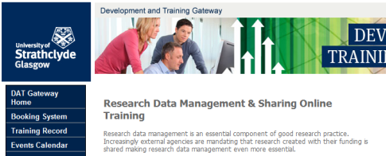
Systems, Tools & What they Do for You
Active Research
Planning
Research Completion
Network Drives

Slide 8
Innovative, user-led, technological solutions . . .
£2.4m replacement of storage
2PB of available storage = 2,097,152GB
Corporate Cloud
. . . . to support behaviour change . . .
Notes:
As I said at the outset of the of the RDMS project our survey showed that not only were the systems we had in place not well understood by users at Strathclyde but they were often inadequate. Working with ISD infrastructure the RDMS project has been able to completely replace the storage infrastructure at the university in order to make it fit for purpose, robust, reliable and vast. This means that we are now in a position to meet the needs of our staff and PGRS for electronic storage.
But having the infrastructure is one thing….

Slide 9
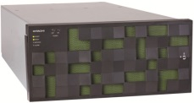
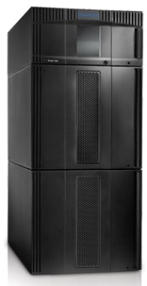
Storage Infrastructure
Building 1
180 TB “block storage” array
Building 2
Brocade SAN (dual fabric)
Exact replica of building 1
2 PB “file storage” array, and HNAS 4100 cluster
Building 3
Tape backup - Quantum Scalar i500
Building 4
Tape backup - Quantum Scalar i500
Notes:
All the methods of storage hosted at Strathclyde are based on the new infrastructure I mentioned earlier which is constructed as shown on the slide. So any data put into h drive, I drive or strathcloud is replicated to two separate locations on campus and is then backed up to two further locations. The storage is dual fabric which means that if one side goes down the other will immediately take over without a break in service.
- Centrally provided storage
- Replicated and backed up to multiple locations
- Robust, resilient, secure & protected
- Huge capacity
- Accessible to external collaborators

Slide 10
Mapped drives (H: and i:)
Awareness
Make it bigger…
And bigger… (10-fold increase in H: drive default quotas, 40-fold for PGR’s)
And bigger (25-fold increase in actual data stored on i: drive, from 14 TB to 350 TB in 18 months)
External collaborators

Slide 11
Strathcloud
Sync-and-share solution (“Corporate Dropbox”)
Citrix Sharefile
All data held on-campus
Target-usage :
Staff / PGRs / external collaborators
Small / medium quantities of data
Active data

Slide 12
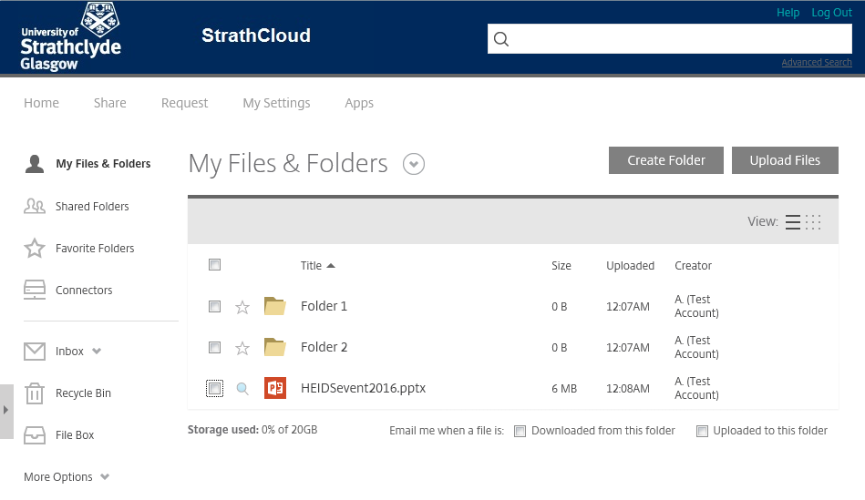
Strathcloud

Slide 13
Storage Usage
Strathcloud user-data (GB), and active users
HNAS total user-data (TB)

Slide 14
Possible Future Developments
Strathcloud
Data Migration Tool
Rightsignature
Collaborative editing
Storage
Continued expansion
File vs object storage
No more tape backup?

Slide 15
Completed Dataset Deposit
Pure
Metadata check & Approval
Initial Preservation checks
KnowledgeBase
Metadata and Data dissemination
Dataset Metadata
Dataset Files
Archivematica
Further preservation and curation

Slide 16
Completed Dataset Deposit

Slide 17
RDMS in the Library
Customer Services
Information Literacy
Faculty Support
Cataloguing
Open Access/RDMS
Research and Learning Support
Silos and Teams
Subject Expertise
Research support
Roles and Responsibilities

Slide 18
Contact Details
Claire Carroll
Andrew Edmond
Alan Slevin
Email: researchdataproject@strath.ac.uk

